Slide 1
4.07 Weather/Working Conditions
A Policy Recommendation

Slide 2
Goals
Describe and analyze the Policy 4.07
Understand implications of Policy 4.07 in students’ lives
Solutions to improve Policy 4.07

Slide 3
4.07 Weather/Working Conditions
It is the policy of the University to continue normal hours of operation and maintain a regular work schedule for staff members during periods of severe weather and/or adverse working conditions. It is a basic premise of this policy that University faculty, staff, and students shall have the opportunity to make their own decision about reporting to work or class with due consideration for travel safety conditions.

Slide 4
Attendance Policy Examples
Communications Department:
Attendance and Tardiness – To be successful in this course, you need to attend class. Attendance will be taken. You have two free absences regardless of the reason. Each subsequent absence will result in a loss of 5 points from the final grade, except for absences due to university related events, deaths or serious illnesses and these must be documented where possible, the day after the absence. It is best to notify the instructor ahead of time if you need to be absent. Excessive absences or tardiness may result in failure of the course.

Slide 5
Attendance Policy Examples
Department of Philosophies and World Religion
Excused absences: Excused absences have documentation that you will need to show me. UNI-sponsored events that come with documentation. Illnesses where you have a written note from a doctor. Obligatory military service or military medical appointments, with documentation. Jury duty with documentation. Court dates, with documentation. Funerals,with documentation.
Unexcused absences: Illness without a doctor’s note. Having to work. Transportation issues. Oversleeping/malfunctioning alarms. Family issues. Doctors’ appointments.

Slide 6
Attendance Policy Examples:
Department of Education:
Each class period, one-two points will be deducted for lack of attending and/or professionalism. (This includes preparedness, punctuality, participation, respect, and appropriate use of technology during class.)

Slide 7
Impact of on Students
Financial
Health and Safety
Education

Slide 8
Financial Impact
CB slipped on Sabin stairs and needed to have X-ray done ($60)
MC went to hospital after falling near Gilchrest
AS drove car into a ditch

Slide 9
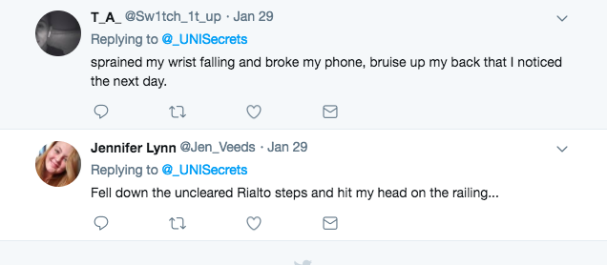
Health and Safety
Dining Staff are essential employees and are required to attend work. JD had to get to work 20 blocks away on polar vortex day or would be FIRED

Slide 10
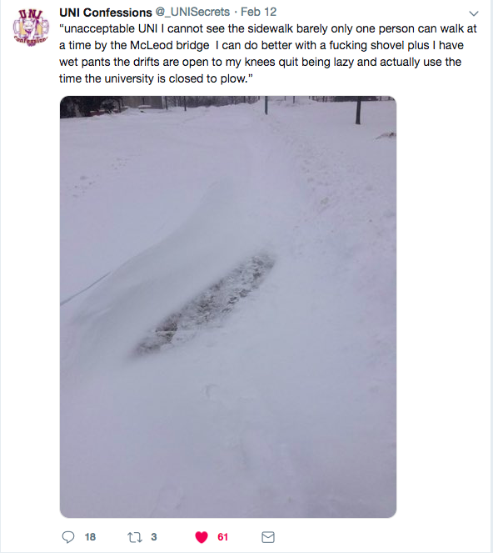

Slide 11
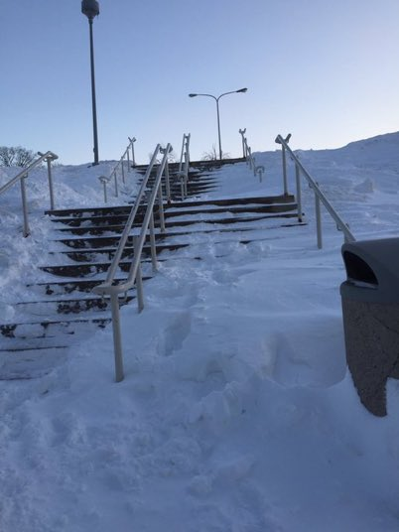

Slide 12
Educational Impacts
Commuting students lose points for missing class leading to failure of the course
Attendance does not equal knowledge in subject
Low performance in class can lead to less financial aid available to students
Failure of course results in financial loss

Slide 13
Proposed Solution
The Provost and Executive Vice President may declare a severe weather day wherein all absences by students must be documented as excused.

Slide 14
Precedent to Policy Proposal
3.06 Class Attendance and Make-Up Work
The following absences must be excused: Required university related absences, including but not limited to athletic games/matches/meets or their equivalents, Absences due to military duty or veteran status, including service-related medical appointments where failure to appear might result in a loss of benefits. Absences because of pregnancy or childbirth for as long as the student’s doctor deems the absences medically necessary. When a student returns to school, she must be allowed to return to the same academic and extracurricular status as before her medical leave began. Legally mandated absences such as jury duty or court subpoena.

