Slide 1
Faculty Senate September 9, 2019

Slide 2
Agenda
-Branding Project Update
-Recruitment Marketing Update

Slide 3
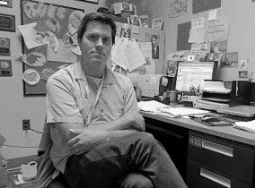
3,423
TOTAL RESEARCH PARTICIPANTS
August 2018
CV LEADERS
FGs & IDIs
(n=21)
PROSPECTIVE STUDENTS & PARENTS
FGs & Online Survey
(Parent n=102
Student n=59)
CURRENT STUDENTS
FGs & Online Survey
(n=547)
UNI FACULTY
Online Survey & FGs
(n=190)
UNI STAFF
Online Survey & FGs
(n=343)
June 2019
HIGH SCHOOL COUNSELORS
Online Survey
(n=84)
ALUMNI
Online Survey & IDIs
(n=1,467)
IOWA BUSINESSES
Online Survey
(n=141)
IOWA GENERAL POPULATION
Mail/Online Survey
(n=423)
IOWA MEDIA
Mail/Online Survey
(n=15)

Slide 4
Common Themes
Current UNI Image/Perceptions
UNI Top of Mind
College of Education | Teacher Prep
Business programs
Right-sized | Mid-sized institution
UNI Dome | Athletics
Definitely Describe UNI
Accessible
Safe
Iowa Focus
Great student experiences
Other Positives
Friendly |Welcoming
Affordable | Dependable | Reliable
Student focused/ centered | Student opportunities
Small*
Small class sizes
Academic quality
*Small image/perception viewed as positive by some and negative by others.

Slide 5
Common Themes
Current UNI Image/Perceptions
Negative Perceptions
LACKS DIVERSITY
Too small*
Limited majors
Suitcase college
UNI Characteristics
UNI is not…
Innovative/Visionary
Up-to-date
Contemporary/Progressive
UNI is too…
Humble/Modest
Conservative/Traditional
UNI Today vs Future
Biggest gaps in…
Diverse population
STEM leadership
*Small image/perception viewed as positive by some and negative by others.

Slide 6
Where Responses Diverged
Undergrads and Alumni tended to be somewhat more positive than other groups for most descriptors.
HS Counselors were generally more positive than other external groups for most descriptors.
Prospective parents/student, general Iowa population and Iowa Business leaders lack significant familiarity with UNI.
Out-of-state prospective students/parents were largely unfamiliar with UNI.
As expected, students/parents of color were especially sensitive to lack of diversity and racial incidents on campus.
Some qualitative and quantitative differences across on-campus groups on individual issues.

Slide 7
Opportunities
Increasing diversity and emphasizing inclusion for all
Known as being welcoming/friendly, but this needs to translate to comfortable place for a diverse population. Need more students, staff and faculty of color.
Need more research with both Latinx and African American populations.
Understand that “small” is double-edged sword
UNI messaging tailored to audiences to help offset “too small” and embrace “right-sized.”
Increase knowledge of the institution to external constituencies
Emphasize breadth of academic opportunities.
Elevate Music/Fine Arts, Communication Sciences & Disorders, and Natural & Social sciences.
Maintain strong/positive reputation of Education/Teacher prep and Business programs.
Address “suitcase college” perception
Work to eliminate the long-standing/continuing perception of UNI being a “suitcase college.”
Identify areas UNI can be perceived as Innovative, Visionary, Modern, Contemporary
Elevate messaging in these areas.
Emphasize initiatives/activities that are bold.
Demonstrate confidence/self-assurance.

Slide 8
Branding
Agency

Slide 9
Scope of Work
Review of brand research
Audit of current marketing assets and messaging
Stakeholder interviews
Competitor brand audit
Brand architecture recommendations
Brand messaging system

Slide 10
Current
University Branding:
“House of Brands” vs. “Branded House”

Slide 11
Current
University Branding

Slide 12
Current
University Branding

Slide 13
Recommended Subbrand
(For current logo)

Slide 14
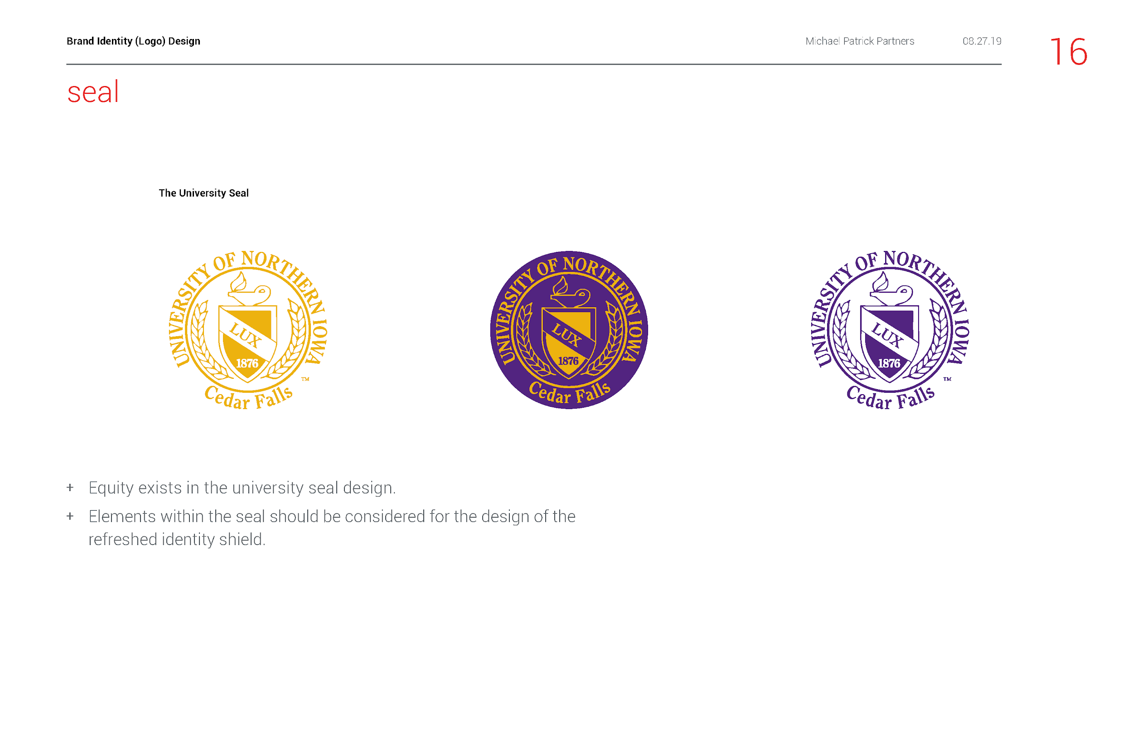
Current
University
Seal

Slide 15
Current
University
Athletics logo

Slide 16
Brand Visual Identity

Slide 17
Wordmarks

Slide 18
Shields

Slide 19
Initial with Logotype

Slide 20
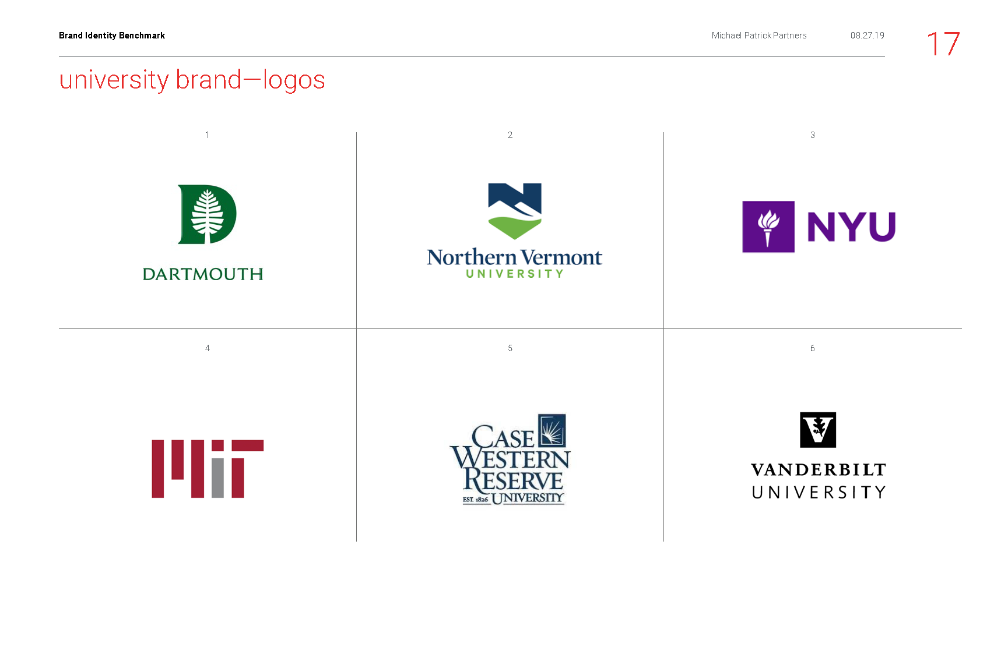
Logos

Slide 22
Shield:
Represents History, Legacy and Tradition

Slide 23
Feedback form
Branding workshop with MPP late September
Target rollout December 2019
Feedback and Next Steps

Slide 24
FY20 RECRUITMENT/STRATEGIC MEDIA PLAN

Slide 25
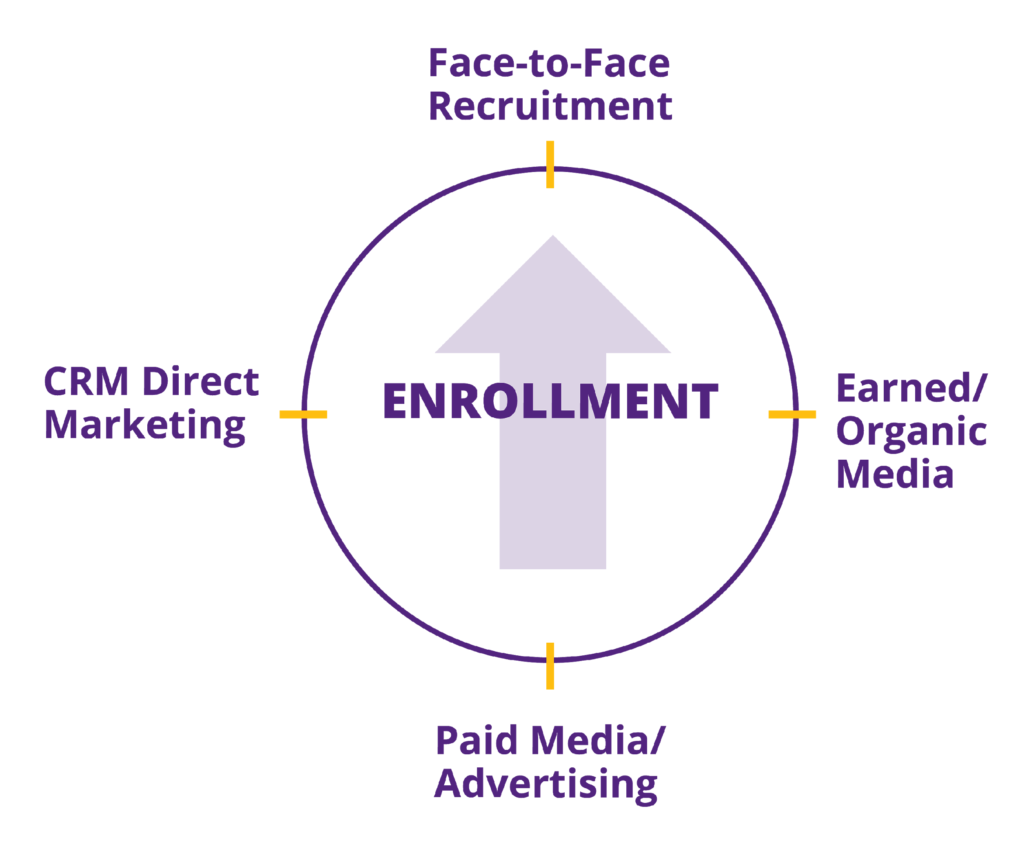
Brand Awareness & Positive Brand Perception
Admissions and University Relations
Partnership

Slide 26
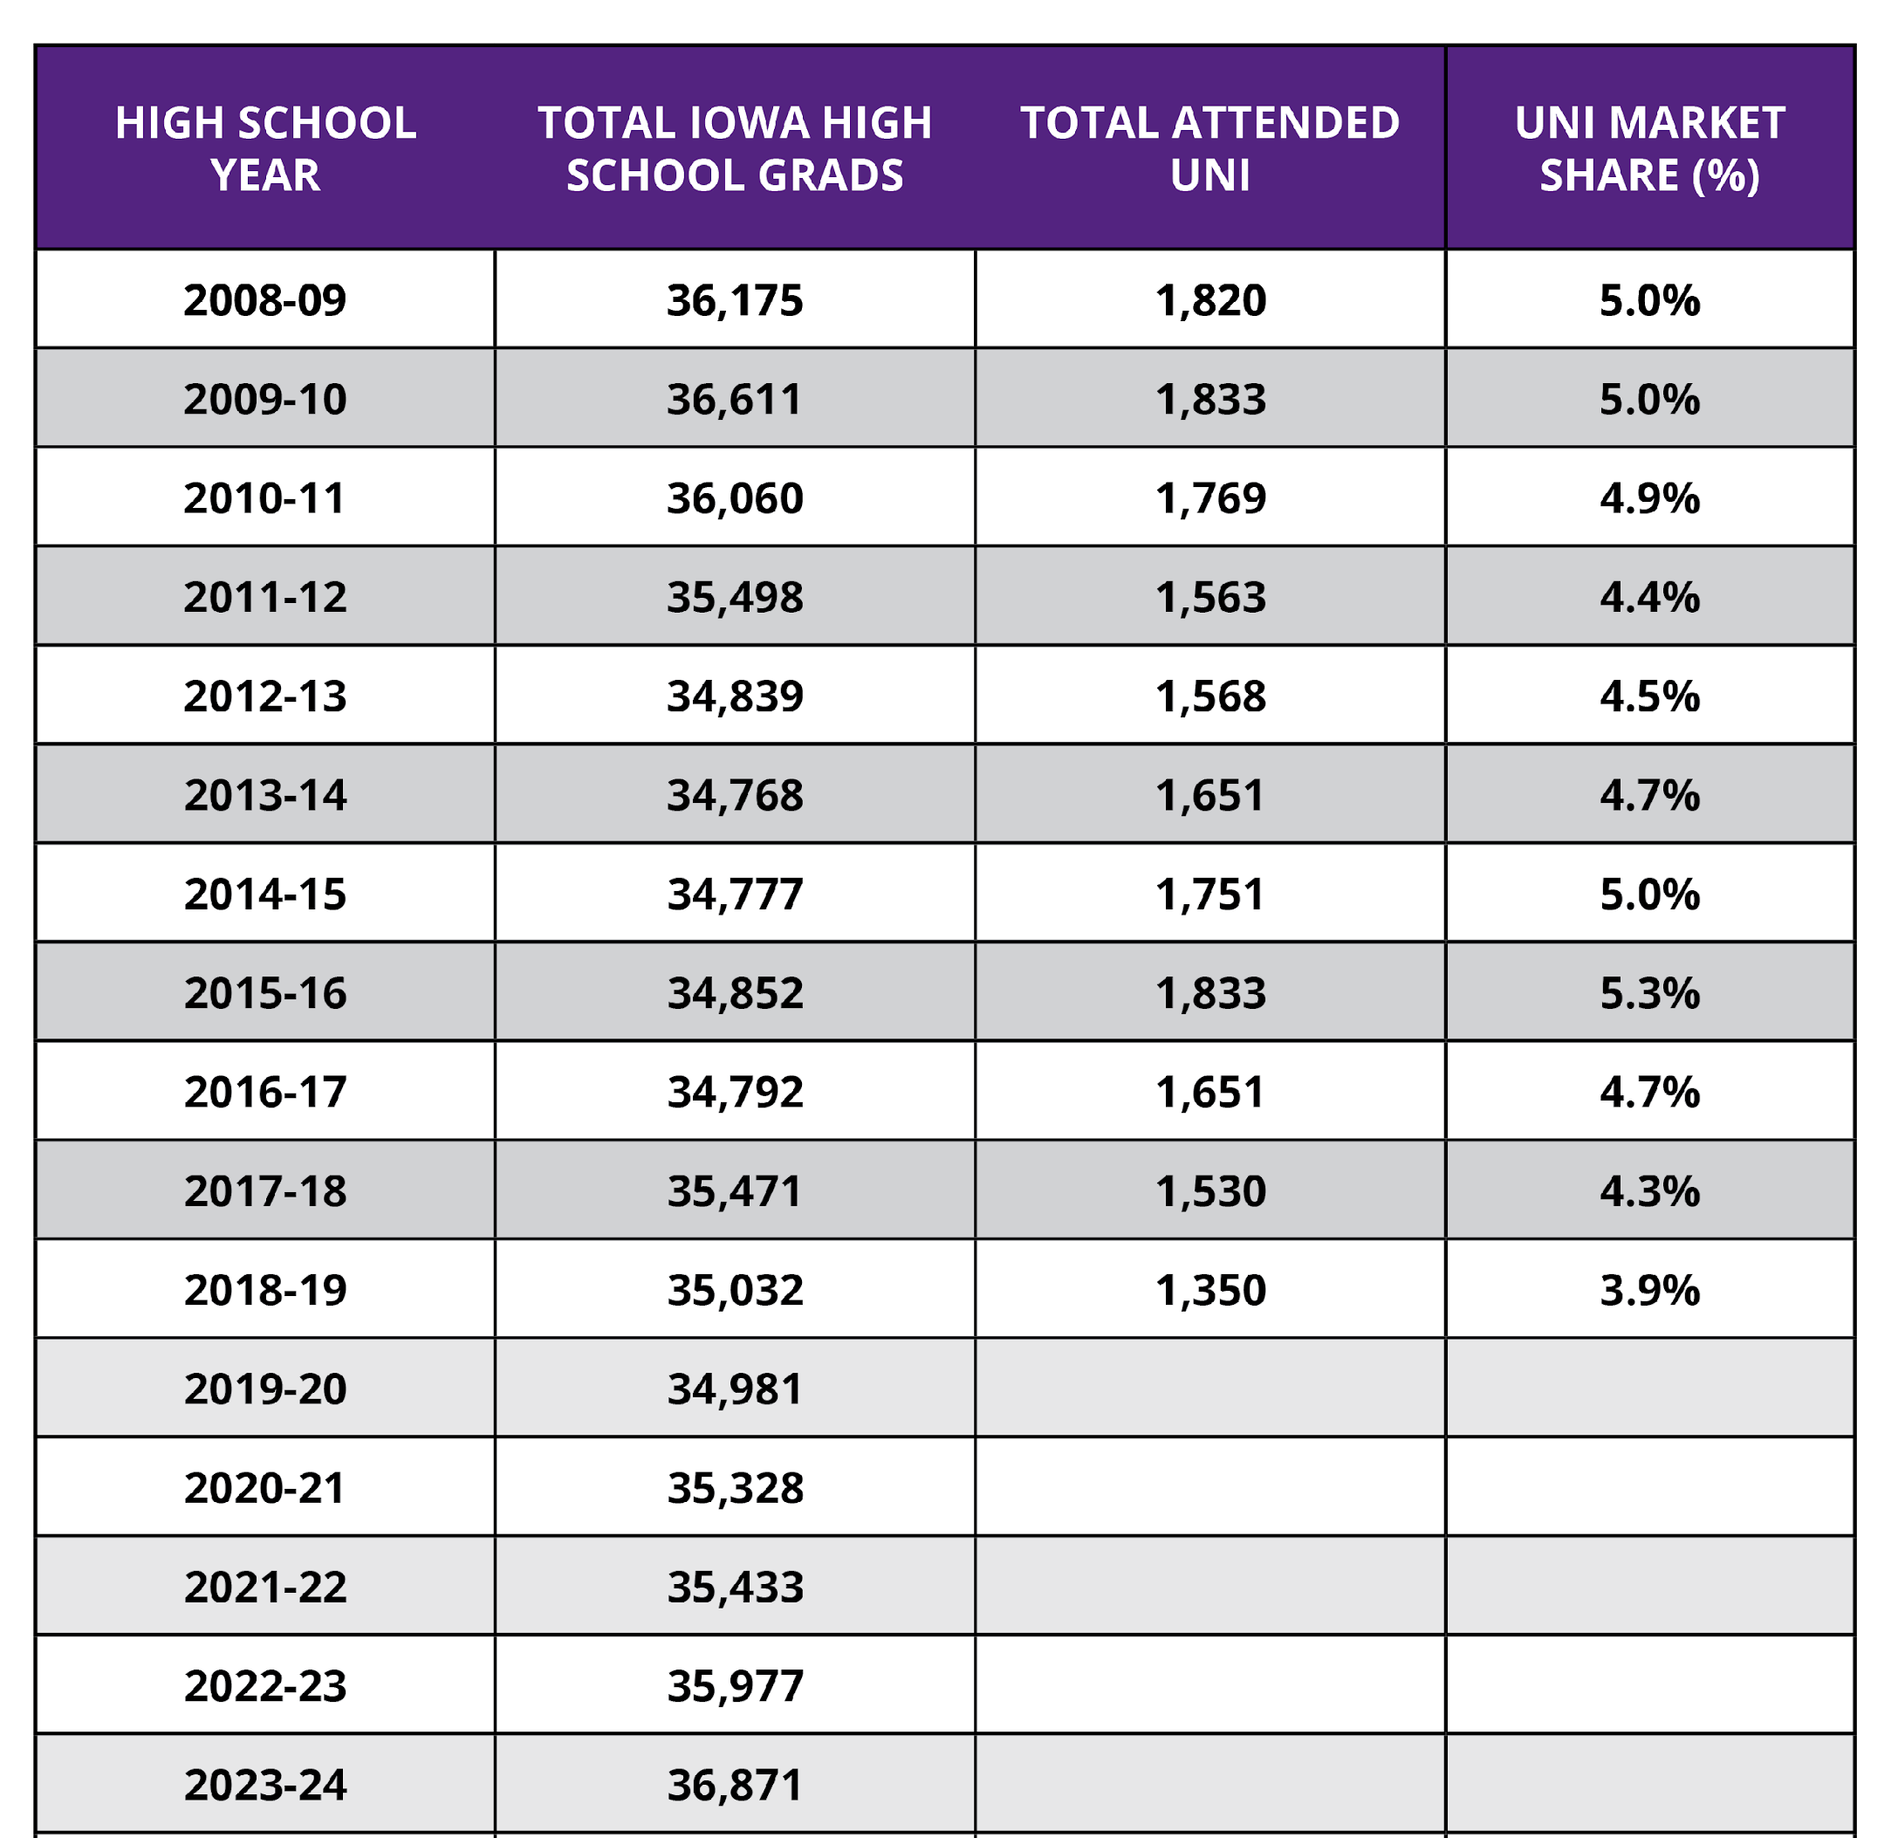
Iowa HS Grads and
UNI Market Share

Slide 27
Enrollment Goals & Admissions Recruitment Initiatives
New Recruitment Initiatives
New in-state and out-of-state scholarships (Fall 2020)
Open House and daily visit improvements designed to highlight academic programs.
Increased outreach and relationship building with community college partners and high school counselors.
New admitted student days, both in-state and out-of-state.
Development of additional translated recruitment materials (Spanish).
First-ever LGBT visit day and continued presence at Pride Fest events.
New out-of-state recruitment fairs, high school and community college visits.
Widening the enrollment funnel through additional ACT/SAT name buying and increased presence in key IL, MN, WI, MO, NE, KS, and SD markets.
Developing and delivering more direct marketing materials.

Slide 28
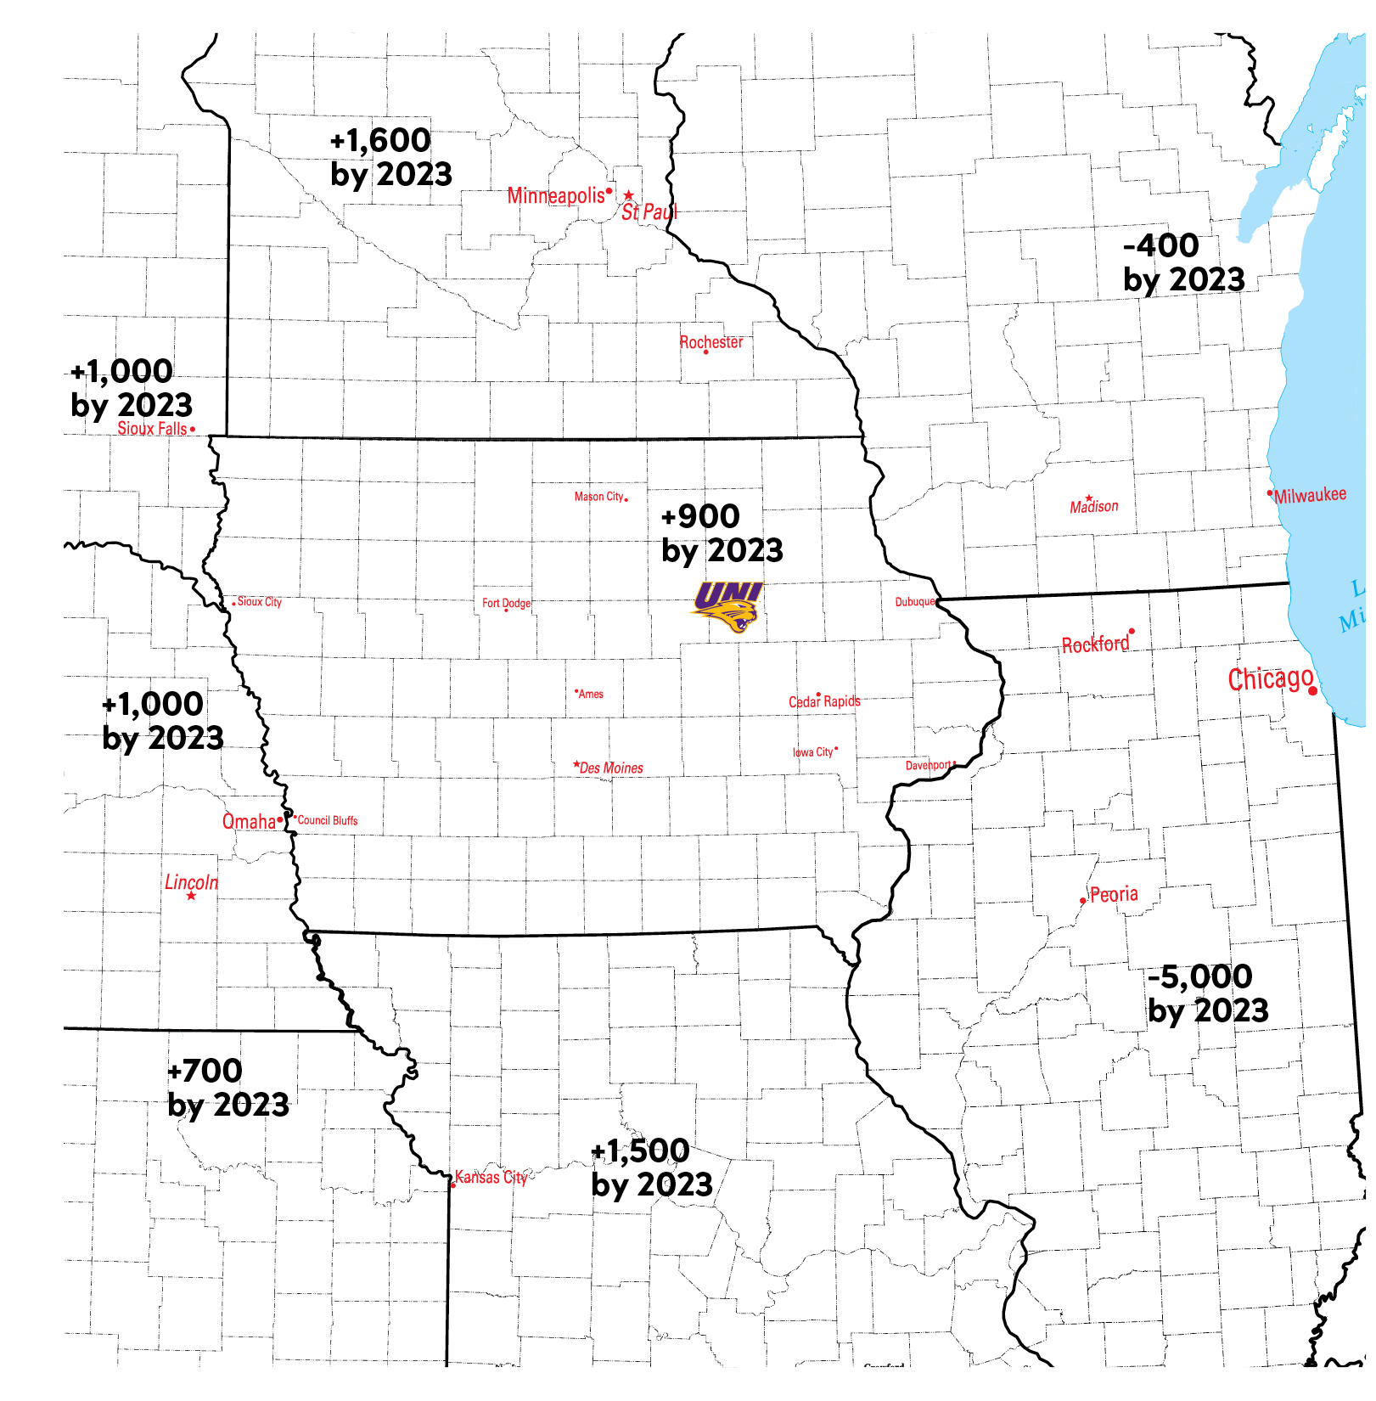
Increases/
Decreases in HS Seniors by State (through 2023)
*Source: WICHE

Slide 29
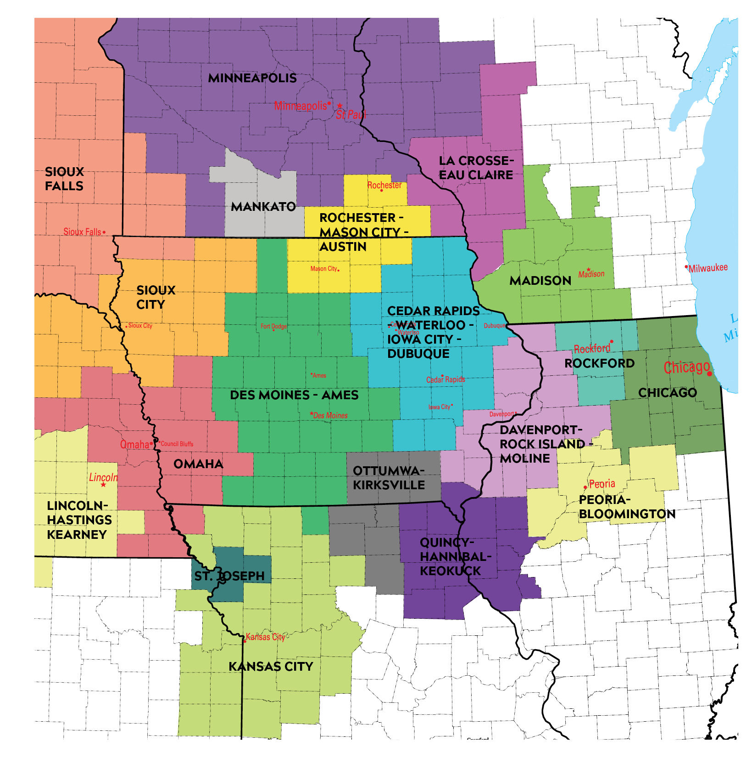
Our Designated
Market Areas (DMAs):
Traditional & Digital Media Plans
JW Morton & Happy Medium

Slide 30
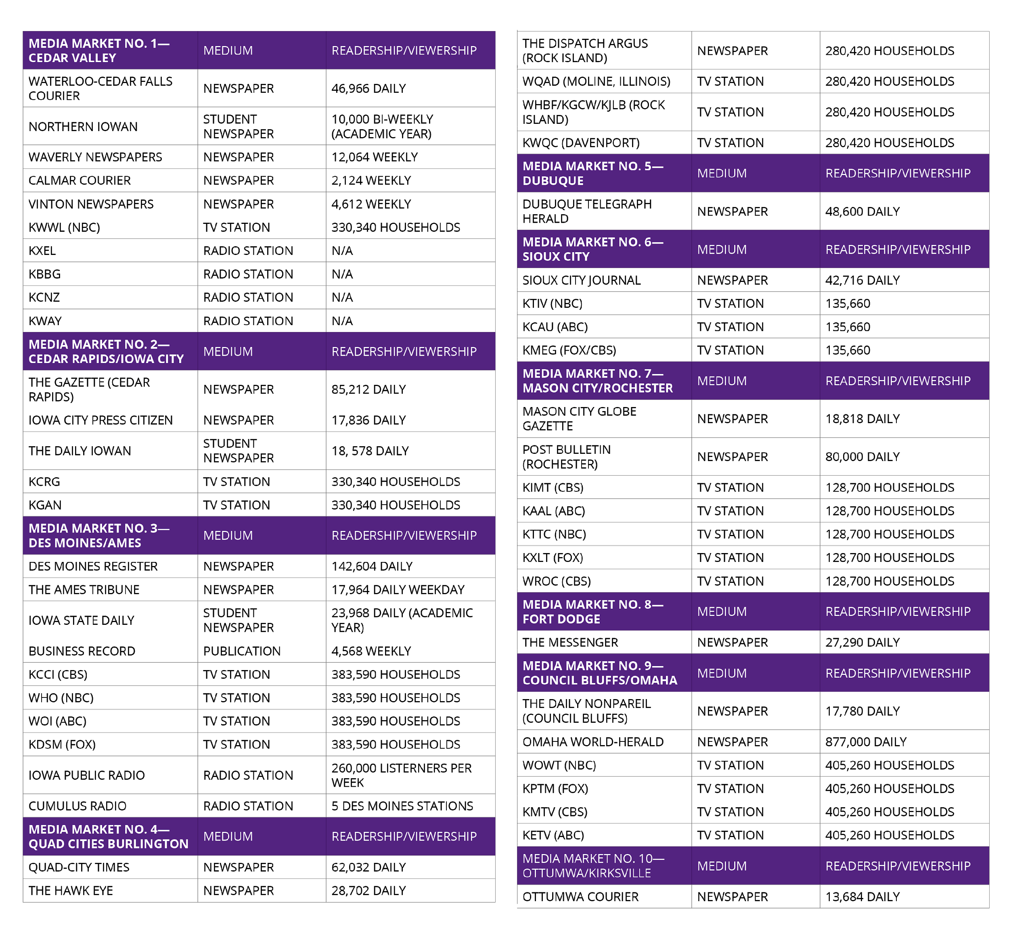
Increasing
Earned Media Efforts

Slide 31
Push to Apply (Seniors/Transfer Prospects) REDESIGNED 51 Emails / 7-10 Pubs (running)
Admits/Commits REFRESHED 38 Emails / 16 Pubs (running)
Search to Prospect (Juniors/Seniors Suspects) NEW 38 Emails / 14 Pubs (near running)
Juniors (Prospects) NEW 28 Emails / 5-7 Pubs
Sophomores NEW 24 Emails / 4-7 Pubs
Freshmen NEW 17 Emails / 2-4 Pubs
Parents; Counselors/Advisors; Visitors; 1st Program Interest NEW Scoped by 8/30
Grad Applicant/Decision Pending NEW 1 Email
International All NEW 24 Emails
International UGRD App/Admit NEW 12 Emails / 1 Pub
International Grad App/Admit NEW 9 Emails / 1 Pub
International Pre-senior NEW 6 Emails
JULY
23
AUG
2
AUG
23
SEPT
CRM Recruitment Comm Flows
SEPT
OCT
TBD
SEPT
SEPT
SEPT
SEPT
OCT

Slide 32
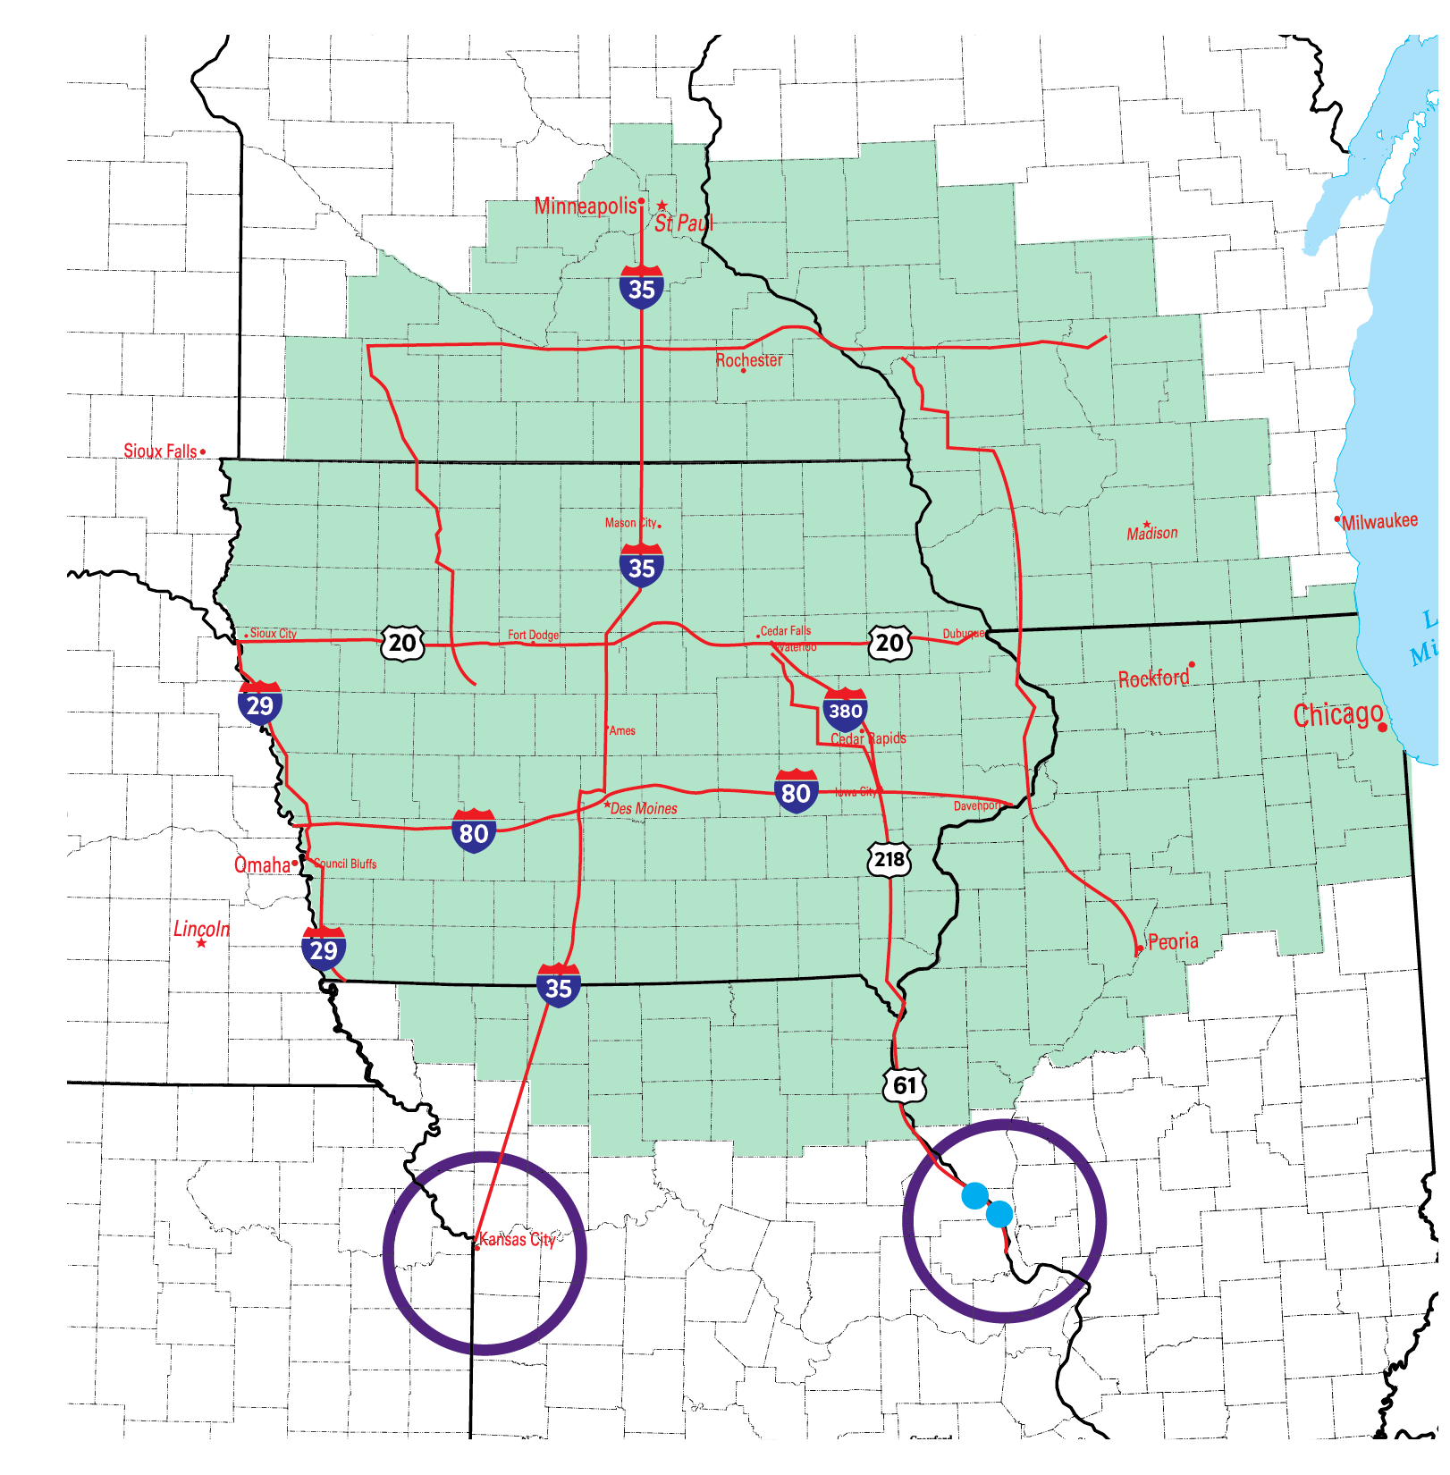
Primary Marketing Area & New
Stretch
Markets
(Kansas City & St. Louis)

Slide 33
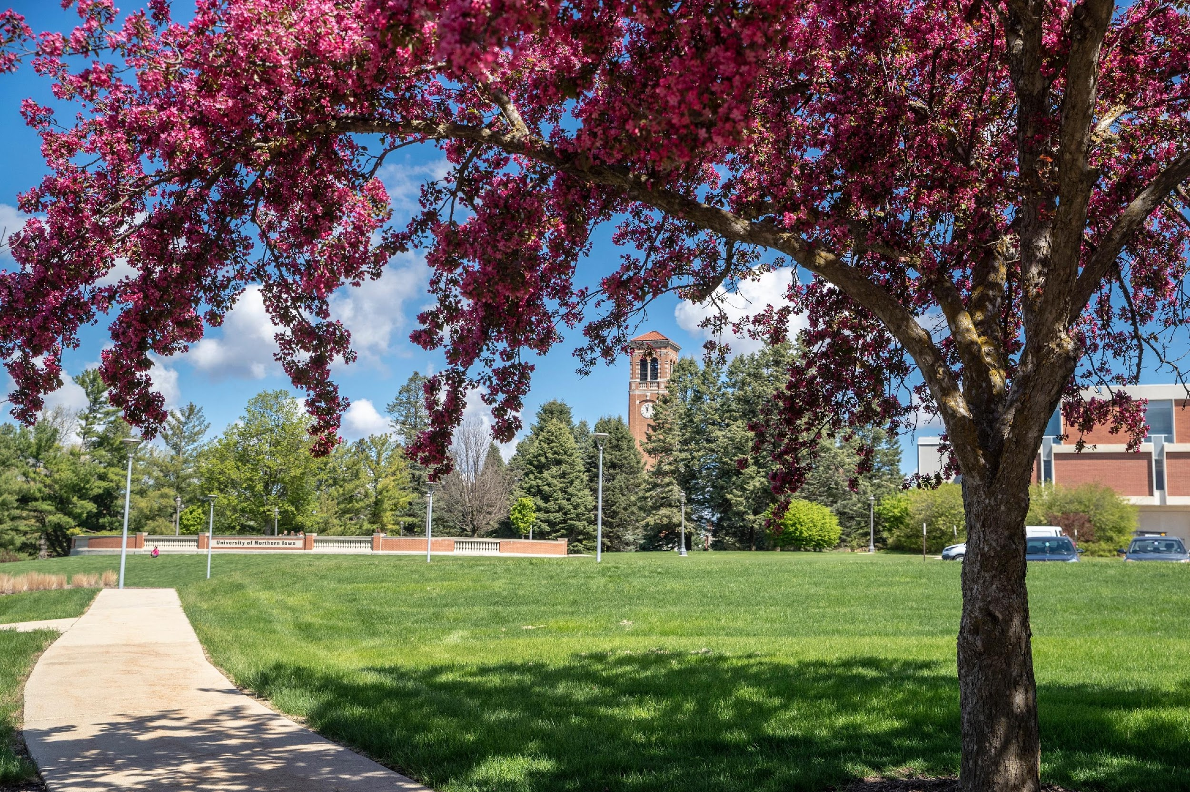
New Recruitment and Marketing Leadership group meeting regularly to track progress and strategize continued synergy
Identification of undergraduate “Programs to Elevate” to aid in marketing prioritization
Continued progress with CRM and direct marketing
Rebranding project/Redesign of website and mobile app
Graduate College growth initiatives
Enhanced video and social media presence/Expanded earned media efforts
Additional Areas of Focus in FY20

Slide 34
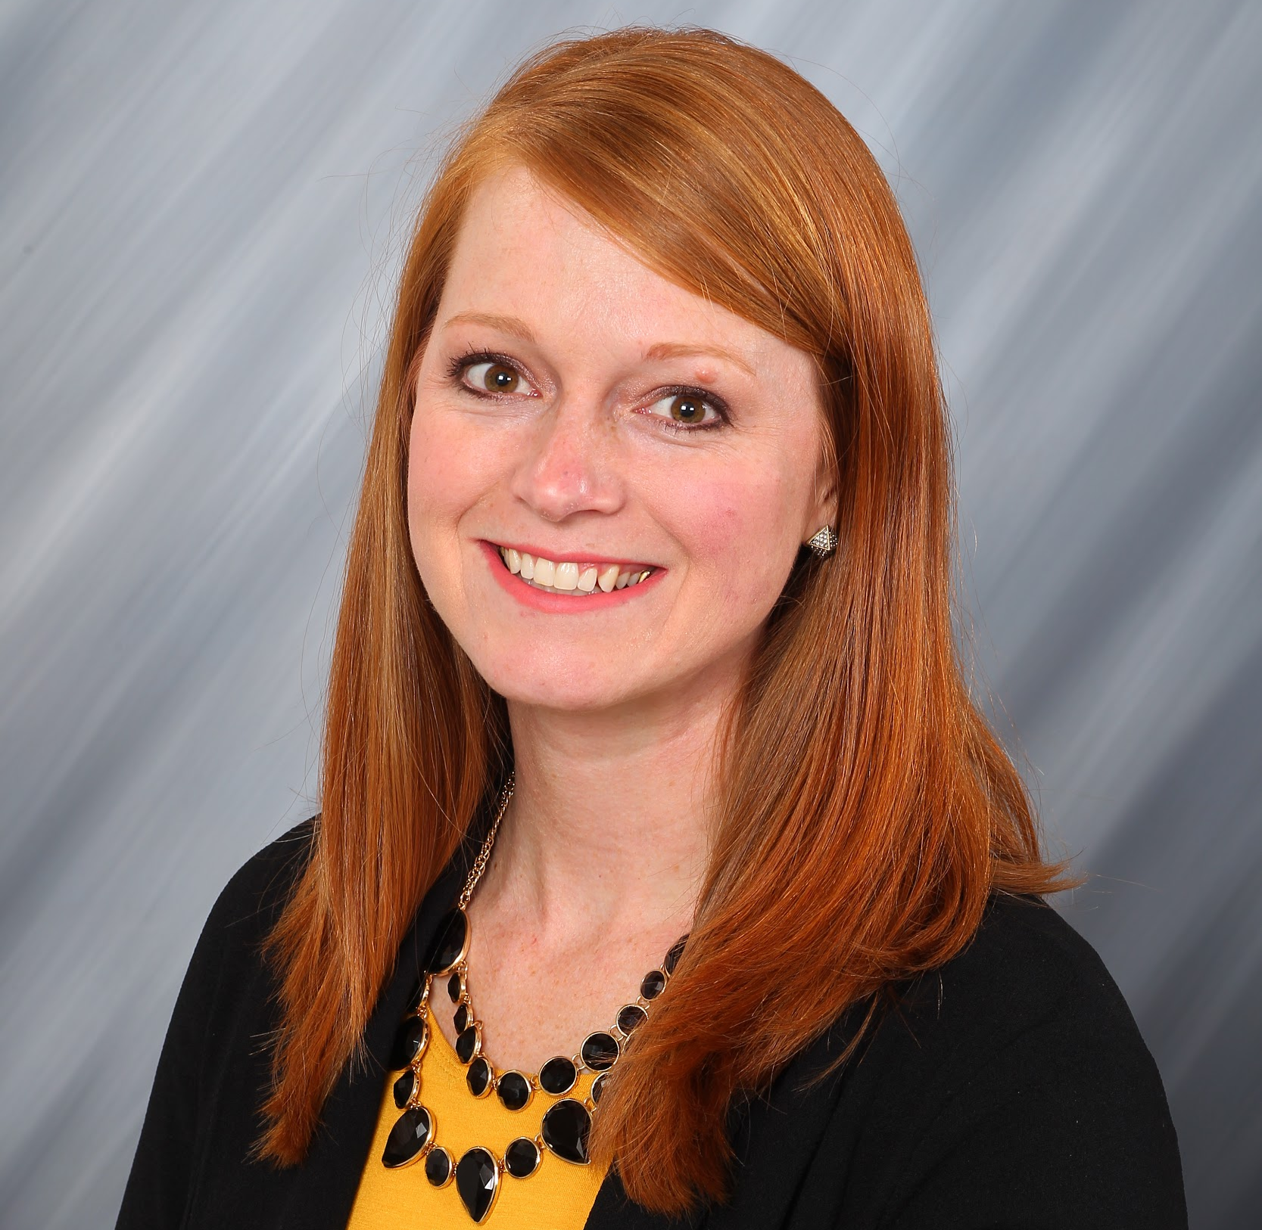
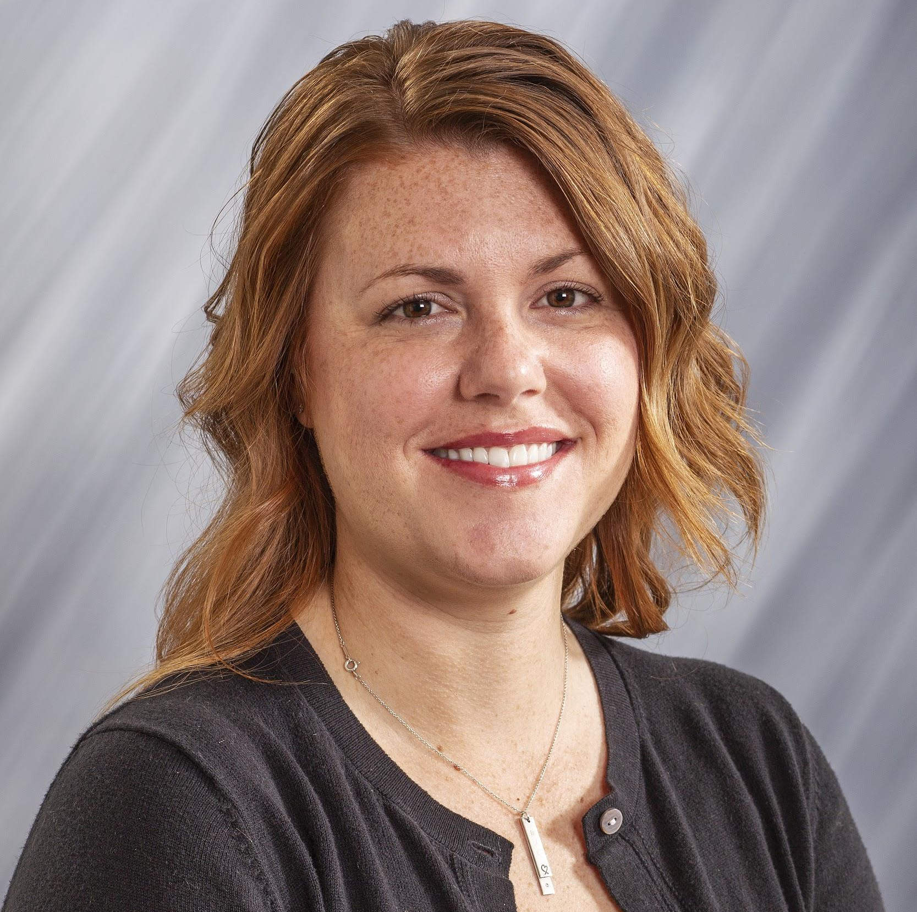
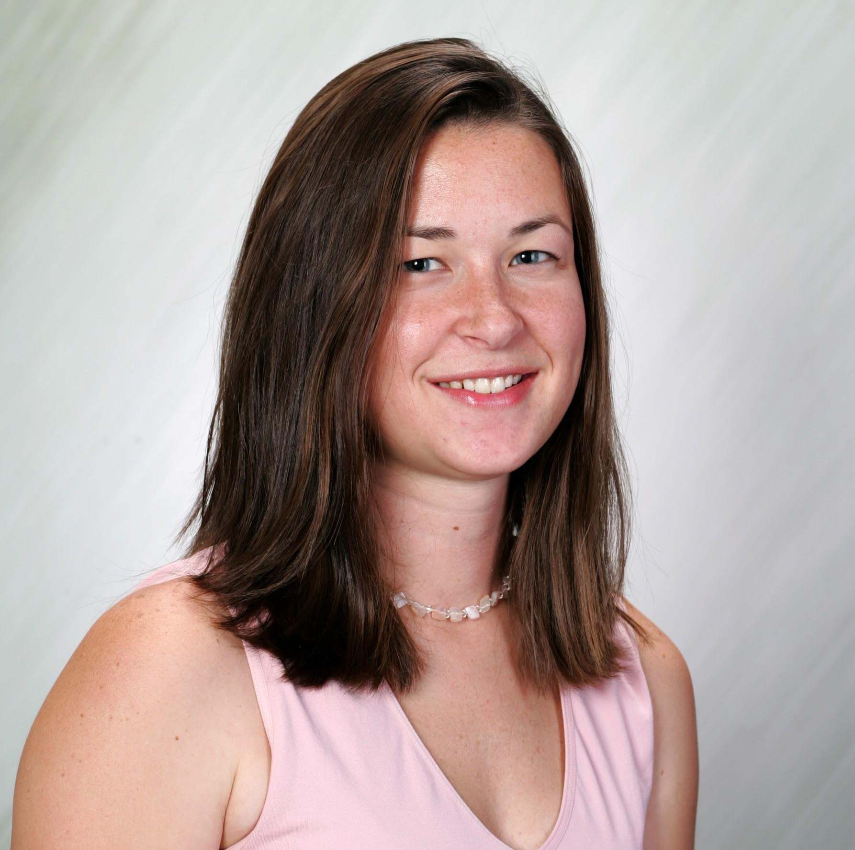
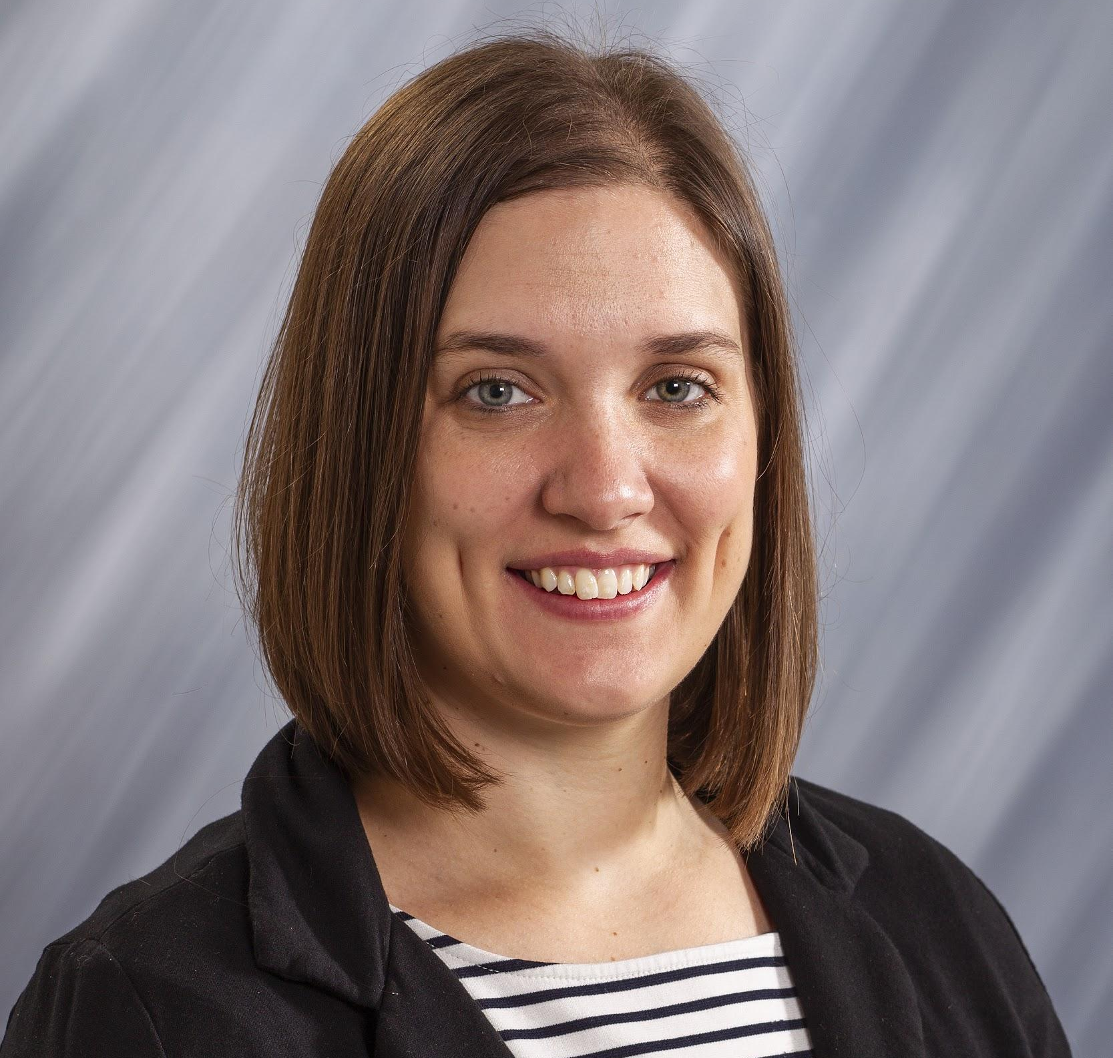
University Relations Leadership
Ashley Stoppel, CRM
Lindsay Cunningham, Web
Jess Betts, Creative Services & Branding
Maddie Allen-Kasten, Advertising
Public Relations Manager - TBD

Slide 35
THANK
YOU

