Slide 1
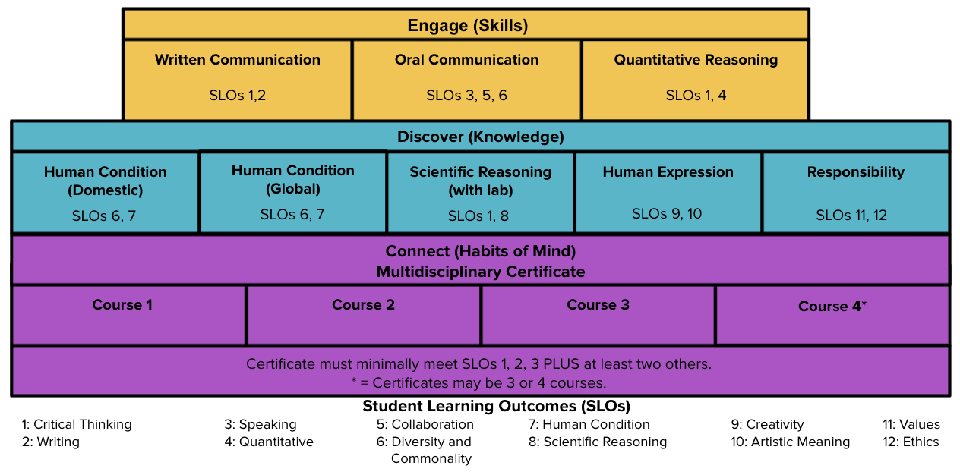
Structure (approved by Faculty Senate 4/10/20, updated & approved April 26, 2021)

Slide 4
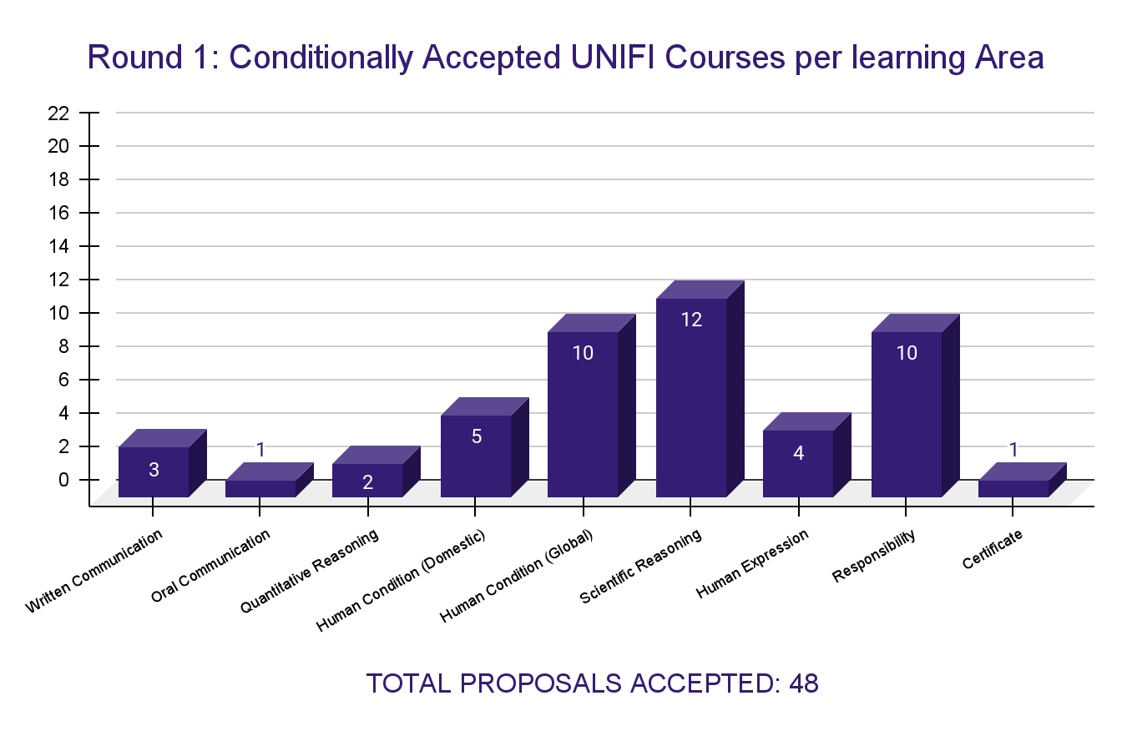

Slide 5
Conditionally Accepted Gold Tier Courses
Written Communication | The Art of Critical Thinking and Writing | PHIL 1XXX
Written Communication | College Writing and Research | ENGLISH 1005
Written Communication | Critical Writing About Literature | ENGLISH 2120
Oral Communication | Oral Communication | COMM 1000
Quant Reasoning | Intro to Stats Methods | STATS 1772
Quant Reasoning | Elementary Logic | PHIL 1030

Slide 6
Conditionally Accepted Human Condition Courses
Human Condition (Domestic) | American Religious Diversity | RELS 3159
Human Condition (Domestic) | US History to the Civil War and Emancipation | HIST 1110
Human Condition (Domestic) | US History since the Civil War and Emancipation | HIST 1120
Human Condition (Domestic) | Survey of American Literature | ENGLISH 2420
Human Condition (Domestic) | Multicultural Literature | ENGLISH 2520
Human Condition (Global) | Religions of the World | RELS 1020
Human Condition (Global) | Peoples, Culture, and Environments | GEOG 1120
Human Condition (Global) | Introduction to Cultural Anthropology | ANTH 1002
Human Condition (Global) | International Relations | POL AMER 1024
Human Condition (Global) | Problems & Perspectives in Global History | HIST 3210
Human Condition (Global) | Perspectives on Death and Dying | PHIL 3110
Human Condition (Global) | Global Social Work | SW 1041
Human Condition (Global) | British Literature I: to Early Modernity | ENGLISH 2320
Human Condition (Global) | British Literature II:Romantics to Post-Colonialism | ENGLISH 2340
Human Condition (Global) | The Holocaust in Literature and Film | ENGLISH 3148

Slide 7
Conditionally Accepted Scientific Reasoning Courses
Scientific Reasoning | Archeology for Beginners | ANTH 2XXX
Scientific Reasoning | Planet Earth | GEOG 1210
Scientific Reasoning | Inquiry into Life Science | SCI ED 1200
Scientific Reasoning | Life: the Natural World | BIOL 1012 & 1013
Scientific Reasoning | Life:Continuity and Change | BIOl 1014 & 1015
Scientific Reasoning | Life: the Natural World | BIOL 1012 & 1013
Scientific Reasoning | Life:Continuity and Change | BIOl 1014 & 1015
Scientific Reasoning | General Physics I | PHYSICS 1511
Scientific Reasoning | Physics I for Science and Engineering | PHYSICS 1701
Scientific Reasoning | General Chemistry I-II | CHEM 1130
Scientific Reasoning | Principles of Chemistry | CHEM 1010
Scientific Reasoning | General Chemistry I | CHEM 1110

Slide 8
Conditionally Accepted Human Expression and Responsibility Courses
Human Expression | The Power of Myth | RELS 3159
Human Expression | Musicking and the Sociality of Creativity | MUSIC XXXX
Human Expression | Visual Perceptions | ARTHIST 1004
Human Expression | Elements of Creative Writing | ENGLISH 2700
Responsibility | Conflict and Justice in History | HIST 3110
Responsibility | Economics of Social Issues | ECON 1001
Responsibility | Science, Technology and Ethics | PHIL 1059
Responsibility | Justice & Good Life: Philosophical Perspectives | PHIL 1XXX
Responsibility | Bioethics | PHIL 3510
Responsibility | Introduction to Public Health | PH 1101
Responsibility | Atoms All Around | CHEM 1059
Responsibility | Natural Resources and Civilizations | EARTHSCI 3335
Responsibility | Ethics in Communication | COMM 4236
Responsibility | Democracy and Education in the 21st Century | SOCFOUND XXXX

Slide 9
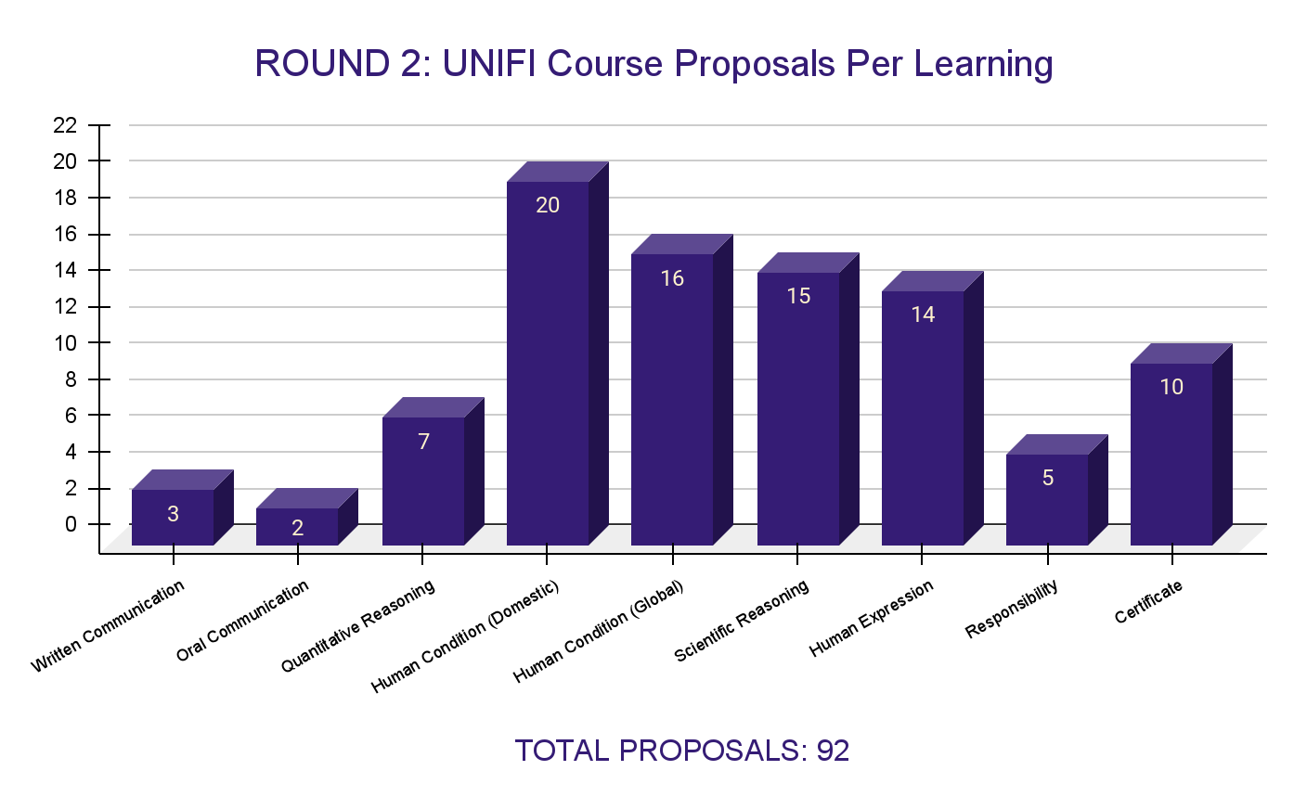

Slide 10
