Slide 1
Self Phishing Senate Presentation September XX, 2018
Information Security

Slide 2
What?
“Phishing” messages from our vendor sent to campus staff and faculty
Goal is EDUCATION
NEVER punitive
Information Security

Slide 3
Why?
The bad guys do it for fun and profit
Information Security

Slide 4
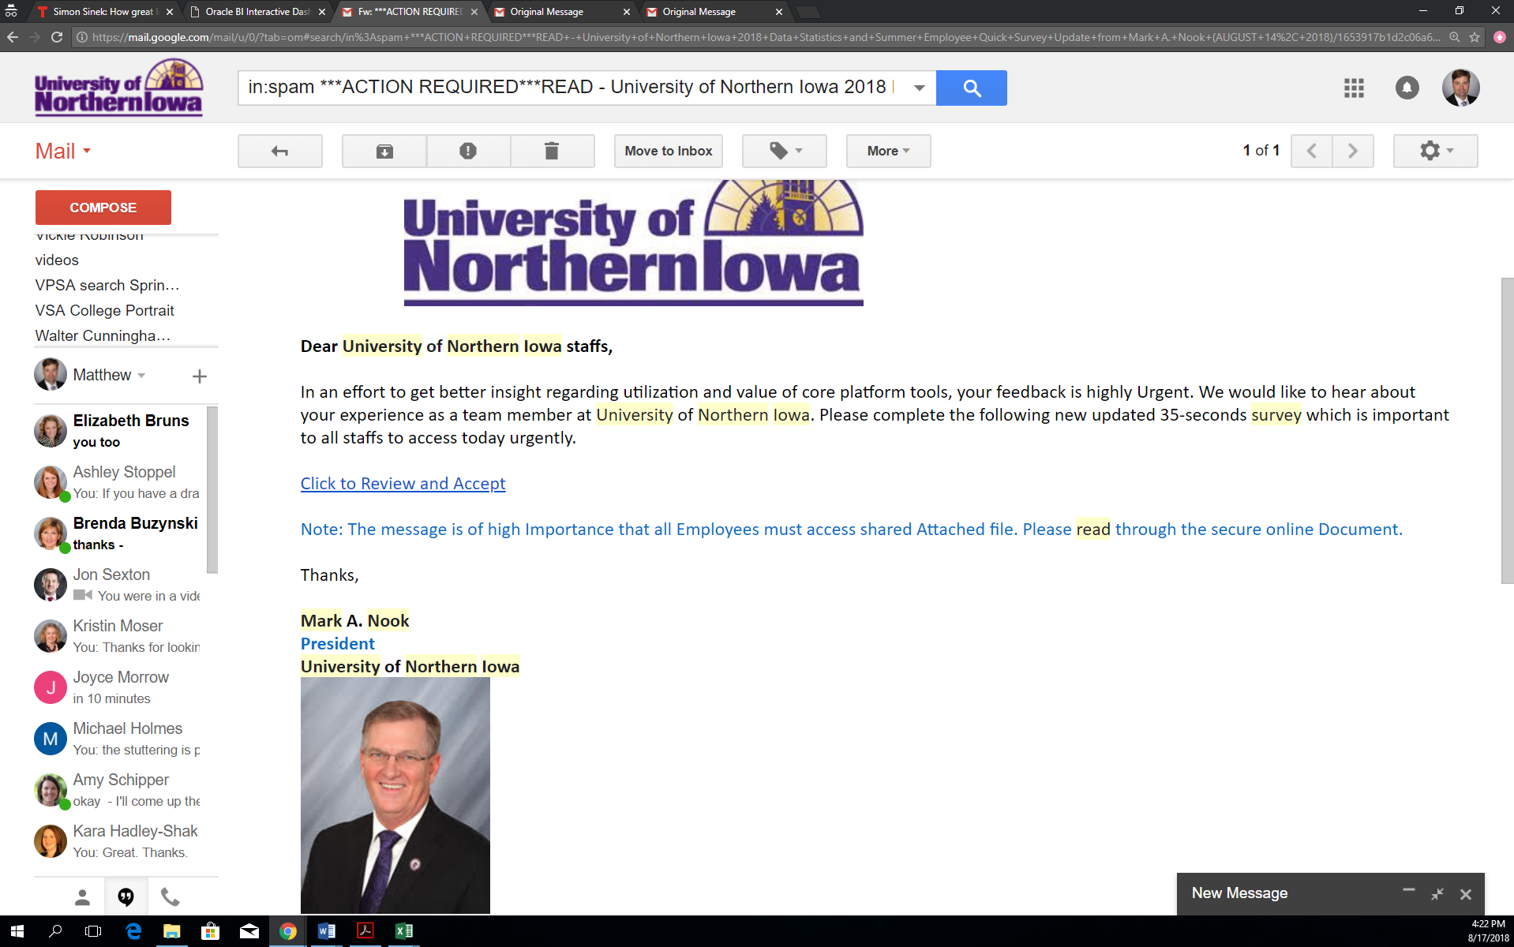
Information Security

Slide 5
Why?
The bad guys do it for fun and profit
We should do it to ourselves to provide education and training for the campus community
Information Security

Slide 6
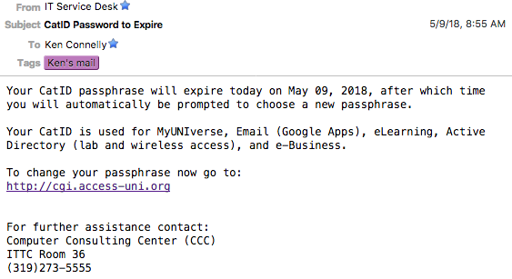
Information Security

Slide 7
Breaking news…
On Friday we had a compromised local account send out a phishing message to a lot our our users. The attacker appeared to go through the compromised account's sent emails and reply to them changing the body of the message to say "Unable to display this email" with a unique link for "Click here to view this message". It went down hill from there as more users fell for the phish and more messages went out. The attacker had control of the accounts only a few minutes after users submitted their credentials. Only thing similar about the links is they were .review domains. Also all the compromised accounts were logged in from the ip addresses below. Since Friday we are close to 200 compromised accounts.
Information Security

Slide 8
How?
Series of several messages
Over the academic year
Begin in October (NCSAM)
Finish by April
Information Security

Slide 9
Support
Security Working Group
UAlbany, UCIrvine, UMiami, Colorado, Pepperdine, UVA, …
Not SUI nor ISU, but …
Routine activity in private sector
Information Security

Slide 10
Who?
Several directors/heads have volunteered
Prefer to go wider
all P&S (750)
All Merit (500)
Faculty (800)
Information Security

Slide 11
Questions?
Information Security

