Slide 1
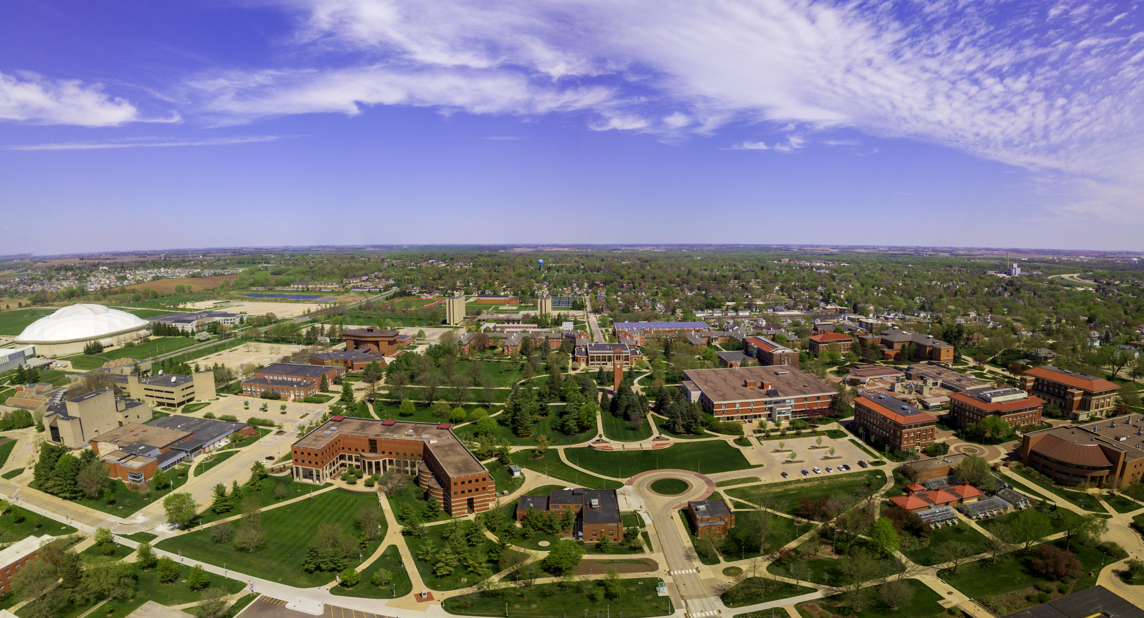
STRATEGIC PLANNING
Notes:
MARK TRANSITIONS TO DREW CONRAD, NICKI SKAAR, AND JULIANNE GASSMAN

Slide 2
2023-28 STRATEGIC PLANNING PROCESS
AUGUST
Strategic Planning Process Launch
OCTOBER-DECEMBER
Campus and Community Input Gathering Sessions and Survey
APRIL
Strategic Plan Finalization
2021
2022
SEPTEMBER
Focus on Vision and Mission
JANUARY-MARCH
Strategic Plan and Metric Development and Refinement
Notes:
SPC
Drew Conrad
The 2023-2028 strategic planning process launched this month. Nicki and I want to thank the over two dozen individuals who agreed to serve on the Strategic Planning Committee and to serve the UNI community.
The strategic plan that is developed over the next nine months will serve as a stepping stone for us as we work toward achieving our Future Vision for UNI in 2051. The new strategic plan will reflect what we as a campus community hope to accomplish over the 5 year life span of the plan and will help move us toward what we aspire UNI to become by 2051.
The 2023-2028 UNI strategic plan cannot be developed without your help.
Nicki Skaar
As you can see on the slide, there will be several months dedicated to gathering campus and community input. There will be multiple opportunities and various methods, for example face to face meetings and a survey, for you to provide input during the Fall semester. We know you are very busy, and we understand adding one more thing to your plate can often seem like too much. We are hoping to make these opportunities as quick and easy as possible! We hope to see you at a face to face session, but if that doesn’t work for you, please add your voice by completing the survey. Your thoughts are very important to us! This is YOUR strategic plan, and it can only be yours if you are involved with the process.

Slide 3
2023-28 STRATEGIC PLANNING PROCESS
Campus and Community Input Gathering
October - December
Strategic Plan Survey
Campus Input Sessions
Community Input Sessions
Students
Faculty
Staff
Others
Students
Faculty
Staff
Alumni Association Board & Alumni
Foundation Board of Trustees
Community Leaders
Employers
Community College Leaders
Prospective Students & Parents
Others
Notes:
SPC
Drew Conrad
The 2023-2028 strategic planning process launched this month. Nicki and I want to thank the over two dozen individuals who agreed to serve on the Strategic Planning Committee and to serve the UNI community.
The strategic plan that is developed over the next nine months will serve as a stepping stone for us as we work toward achieving our Future Vision for UNI in 2051. The new strategic plan will reflect what we as a campus community hope to accomplish over the 5 year life span of the plan and will help move us toward what we aspire UNI to become by 2051.
The 2023-2028 UNI strategic plan cannot be developed without your help.
Nicki Skaar
As you can see on the slide, there will be several months dedicated to gathering campus and community input. There will be multiple opportunities and various methods, for example face to face meetings and a survey, for you to provide input during the Fall semester. We know you are very busy, and we understand adding one more thing to your plate can often seem like too much. We are hoping to make these opportunities as quick and easy as possible! We hope to see you at a face to face session, but if that doesn’t work for you, please add your voice by completing the survey. Your thoughts are very important to us! This is YOUR strategic plan, and it can only be yours if you are involved with the process.

Slide 4
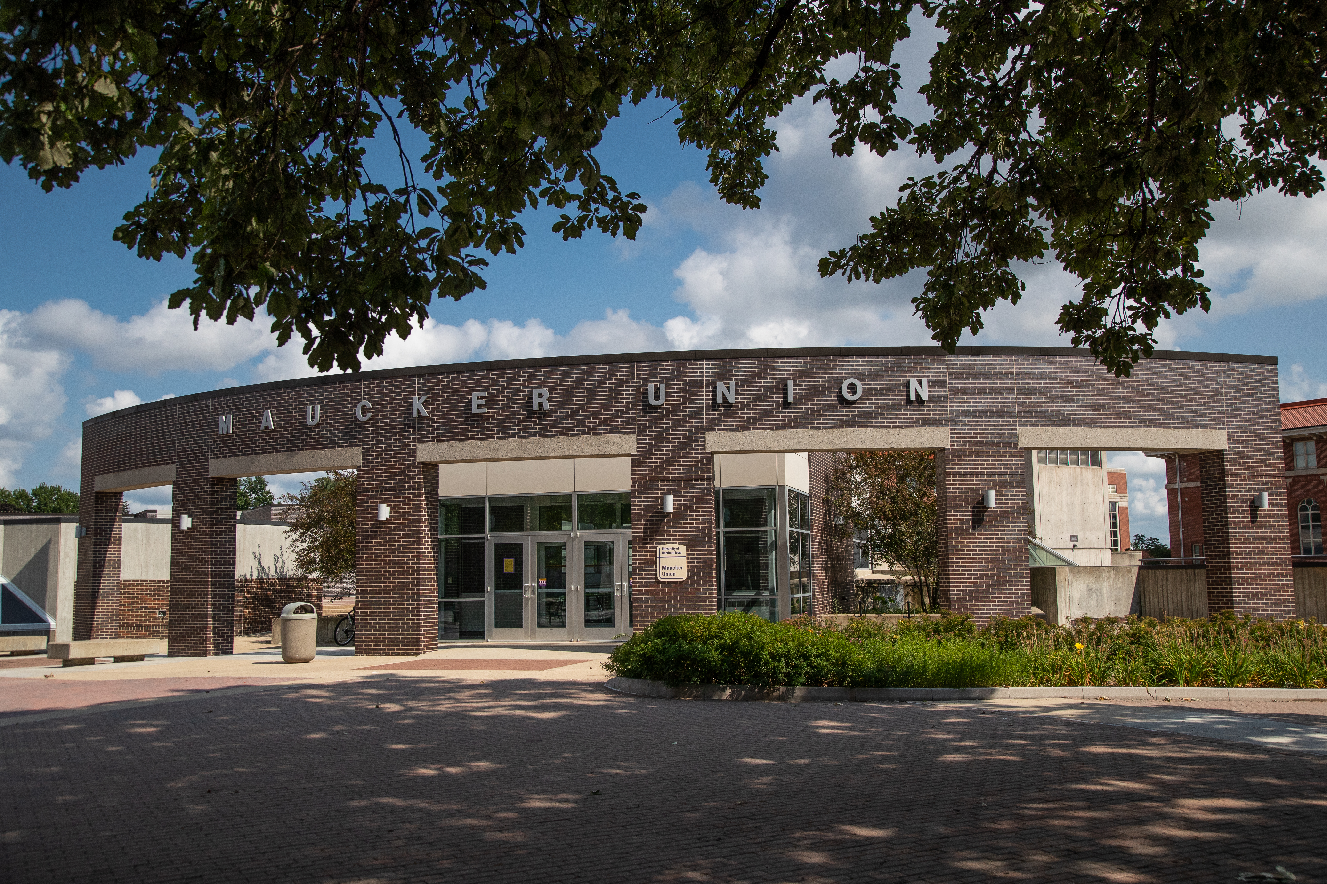
Engage in the Process!
Faculty and Staff Input Sessions
Maucker Union Ballroom
Tuesday, November 2nd from 1-4pm
-or-
Friday, November 12th from 9am-12pm
Survey will be launched in early November
SPC Webpage:
https://strategic-plan-development.uni.edu

Slide 5
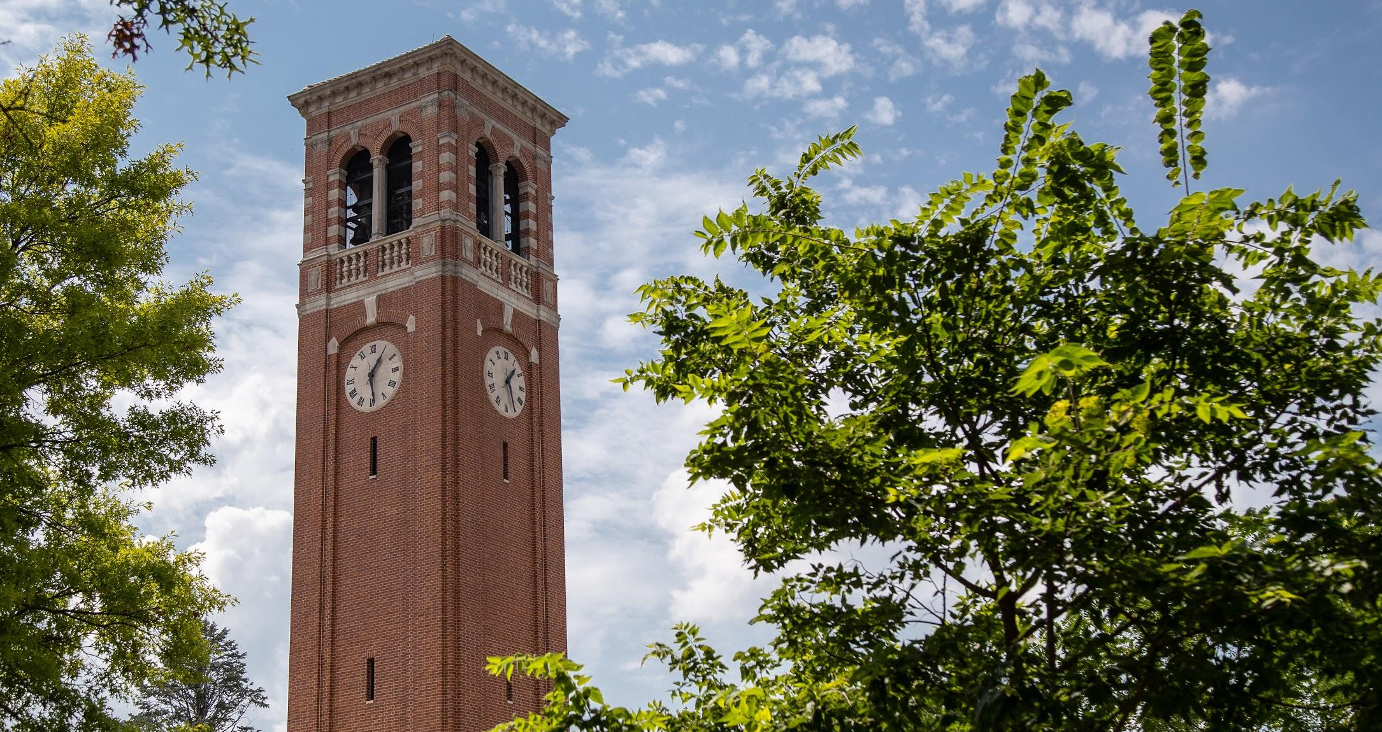
THANK YOU
Notes:
MARK CLOSES US OUT

